Slide 1
Group E Presentation
Lighter, Faster and Accurate Segmentation Model
by Quantization
Members: Anand Vishwakarma, Inhee Park, Sagar Shahi, Sherif Elsaid, Sriram Priyatham

Slide 2
Overview

Slide 3
Introduction
Machine Learning at the Edge
Increasing need for running the prediction and ML models at various edge devices
Nature of the edge devices provides a constraint on both compute and memory
Large Models are harder to distribute to edge devices
Neural Networks are getting larger and more complex
Training ML models is a time and compute intensive task
Training ML models is inefficient in terms of energy consumption and overall cost

Slide 4
Methods for Improving Efficiency of Deep Learning
Improve the Hardware doing the training and running the models
Faster CPUs & GPUs
Use specialized hardware for machine learning (Ex: FPGAs)
Improve the efficiency of the algorithms responsible for training and predicting the machine learning models
Use Model compression techniques

Slide 5
Model Compression Techniques
Quantization
Weight sharing
Pruning
Architecture design
Knowledge Distillation
Others (low rank approximation, winograd transformation, ...etc)

Slide 6
Objective
Using various quantization techniques and by adjusting and experimenting with the different hyperparameters, both during and after the training, we aimed to produce a tensorflow quantized model with comparable accuracy, smaller size, and faster inference time, than the models provides as an example by the original deeplab team.

Slide 7
Networks Choice
We choose to carry out our research using “MobileNet v2” as the backbone network due to its excellent performance and benchmarks on a variety of tasks and the small size and lower latency of its produced models, For the decoder network, we choose to use DeepLab v3+ that’s being developed and maintained by google, it has a proven track record, and is the technology behind some of the advancement on google’s pixel smartphone photography in recent years.

Slide 8
Datasets
Pascal VOC dataset -the main dataset for the majority of the research-
Cityscapes dataset -experimented with it for quantization aware training and inference-
ADE20K dataset -used briefly for running inference-

Slide 9
Details
VOC 2012 dataset
CityScapes dataset
DeepLab V3+ Decoder Network
TensorFlow 1.14
TensorFlow lite

Slide 10
TensorFlow Lite 8-bit Quantization
8-bit quantization approximates floating point values using the following formula
Real_value = (int8_value−zero_point) × scale
Activations are asymmetric: they can have their zero-point anywhere within the signed int8 range [-128, 127]
Weights are symmetric: forced to have zero-point equal to 0.

Slide 11
Quantization Aware Training
Quantization aware Training is very powerful method reducing model size and Improving inference speed
Most Recent techniques are Binarization of the Neural Network
Some of the examples are
Binary Connect
BinaryNet
Binary Weight Network

Slide 12
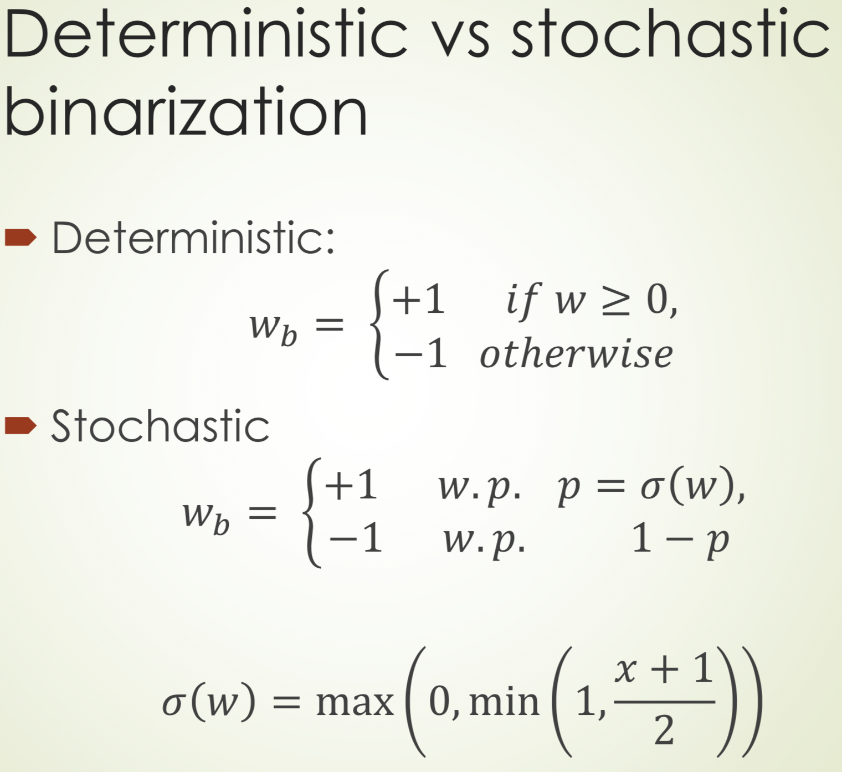
Binary-Connect
W = weights with full-precision
Wb weight with quantized weight
Only weights are binarized
σ(w) hard sigmoid
Weight Binarized for forward-propagation and backward-propagation but not for parameter update

Slide 13
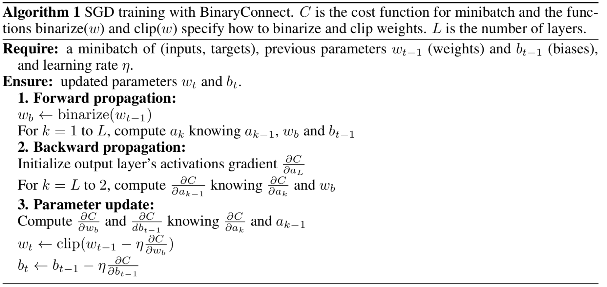
Binary Connect Algorithm

Slide 14
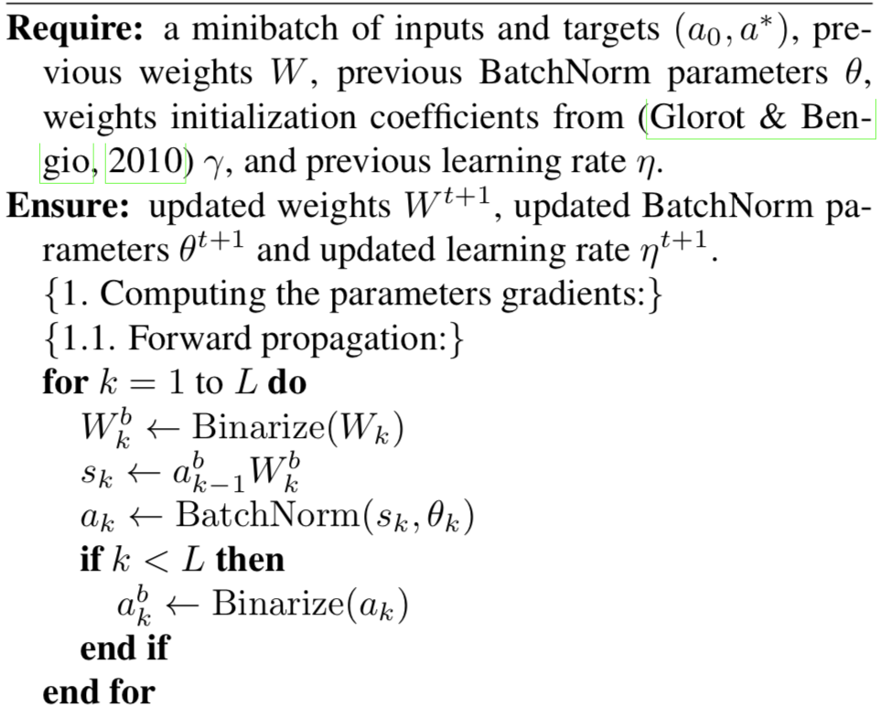
Binary Neural Network
Binary Connect with activations binarized too.

Slide 15
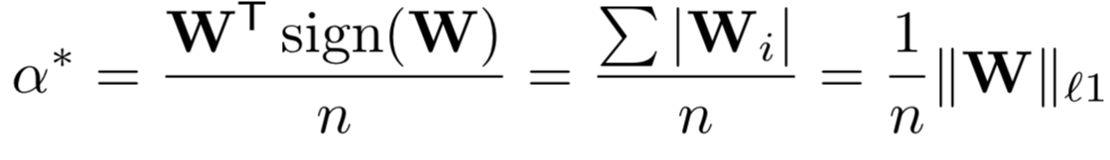
Binary Weight Network
This network uses same concepts as BinaryConnect
The way weights are binarized in different way.
W - real Valued Weights
I - real valued input tensor
* - Convolution operation
I * W ~ (I ± B)𝛂
B - Binary Weights (sign of W)
± Convolution with only addition/Subtraction
𝛂 - Real valued scalar factor (Average of W)

Slide 16
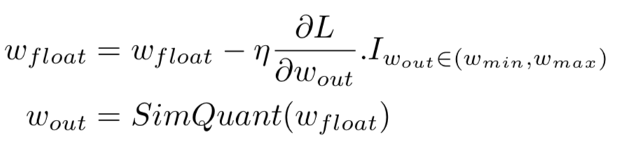
Our Approach
W_{float}
Quantize
W_{quantizedl}

Slide 17
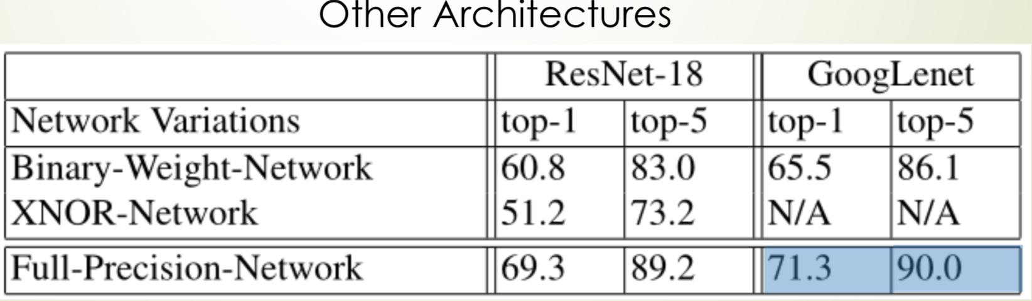
Results on other Architecture

Slide 18
Initial Results:
Inference on DeepLab V3+
pre-trained models (prior Quantization)

Slide 19
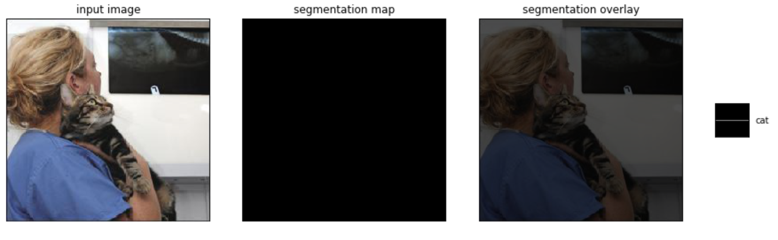
Initial Results
Failed to produce segmentation mask, and an invalid quantization field

Slide 20
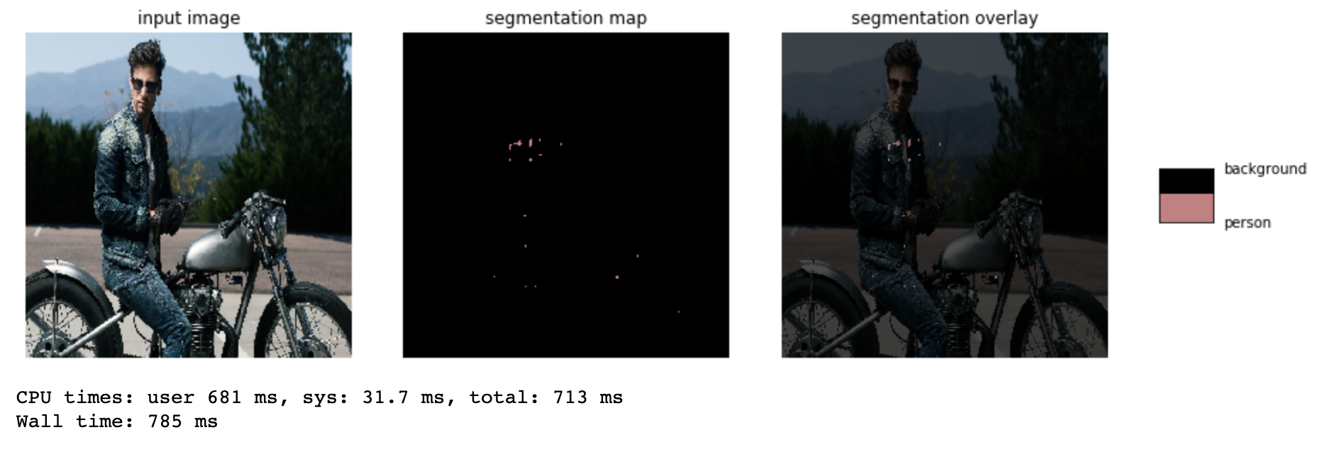
Initial Results
Still Failed to produce segmentation mask, with a valid quantization field

Slide 21
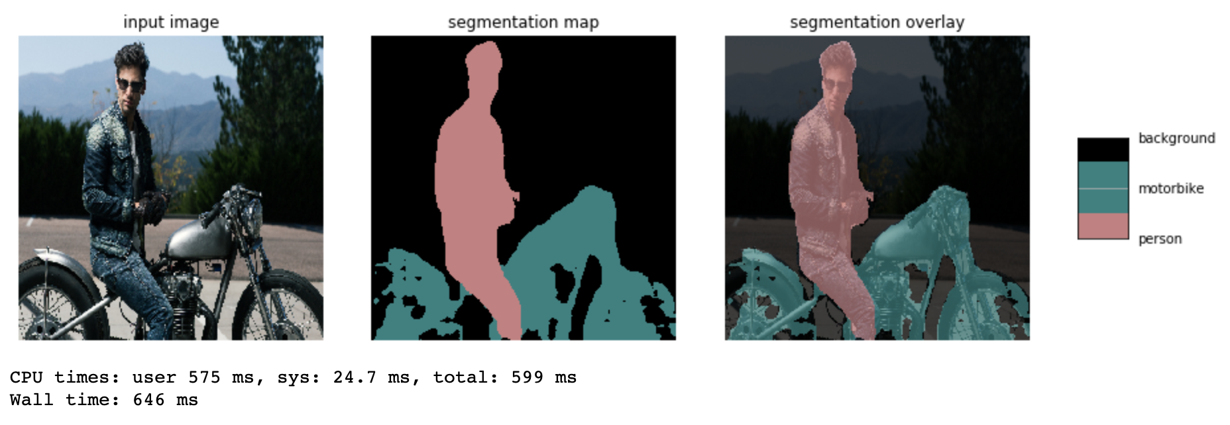
Final Results
Successful inference on quantized model

Slide 22

Comparison with Deeplab authors provided model
Comparable results both in accuracy and inference time

Slide 23
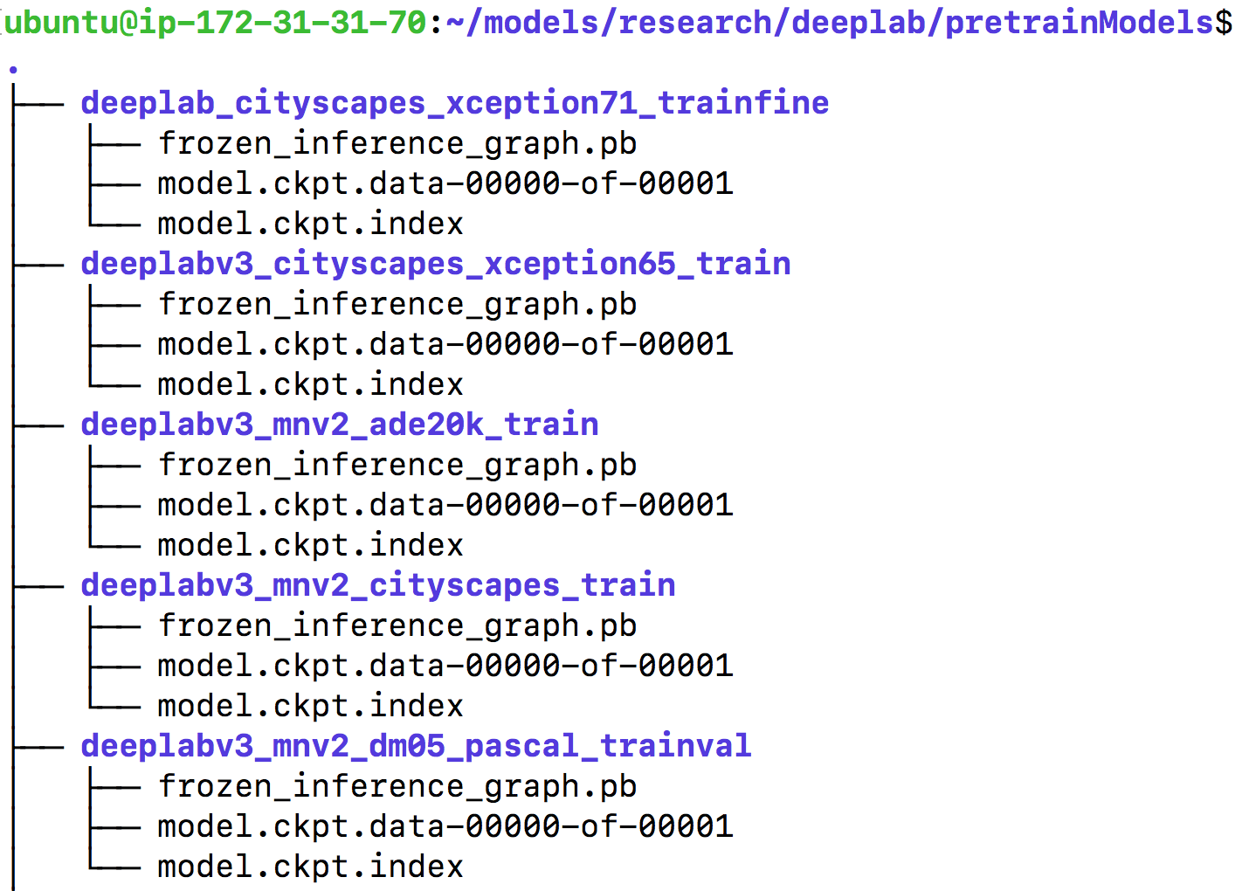
DeepLab Model Zoo in TensorFlow
PRE-TRAINED MODELS
W/ DATASETS
PASCAL VOC 2012 (21 labels)
Cityscapes (35 labels)
MS-COCO (183 labels)
ADE20K (>2000 labels)
ON BASE ARCHITECTURES
MobileNet-v2 (mnv2)
for faster inference
Xception_65, Xception_71
for better inference

Slide 24
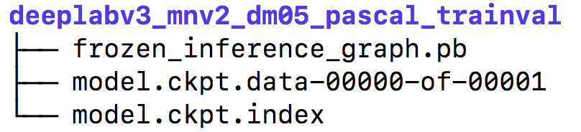
Inference (pb file); Fine-Tuning (ckpt)
INFERENCE = Prediction
pb (protobuf) file is required in TensorFlow;
serialized version of graph (representing data flow of the computations)
contains the GraphDef, weights of the model.
FINE-TUNING = Minimizing Loss Function
Taking weights of pretrained model for a new model
Trained with data from the same domain datas
Benefit: 1) speed up the training; 2) overcome small dataset size
Train.py --fine_tune_batch_norm=true \
--tf_initial_checkpoint=”pretrainModel/model.ckpt"

Slide 25
Transfer Learning (ckpt; new domain dataset)
FINE-TUNING = Minimizing Loss Function
Taking weights of pretrained model w/ PASCAL_DATASET
Trained with data from the same domain
Train.py --fine_tune_batch_norm=true \
--tf_initial_checkpoint=”pretrainModel/model.ckpt" \
--dataset_dir="PASCAL_DATASET"
TRANSFER LEARNING = Domain Adaptation
Taking weights of pretrained model w/ PASCAL_DATASET
Trained with data from the different domain
Train.py --fine_tune_batch_norm=false \
--tf_initial_checkpoint=”pretrainModel/model.ckpt" \
--dataset_dir="ADE20K_DATASET"

Slide 26
Inference Demo on new single image
AWS Deep Learning AMI (Ubuntu 16.04)
$ source conda_tensorflow_p36 (TensorFlow 14.0.0)
$ git clone https://github.com/tensorflow/models.git
$ cd models/research/deeplab
$ jupyter notebook --no-browser --port=8889
On Local Computer
ssh -i ~/.ssh/ipark-aws.pem -N -f -L\
localhost:8890:localhost:8889 ubuntu@52.36.215.36
Run models/research/deeplab/inference_deeplab.ipynb

Slide 27
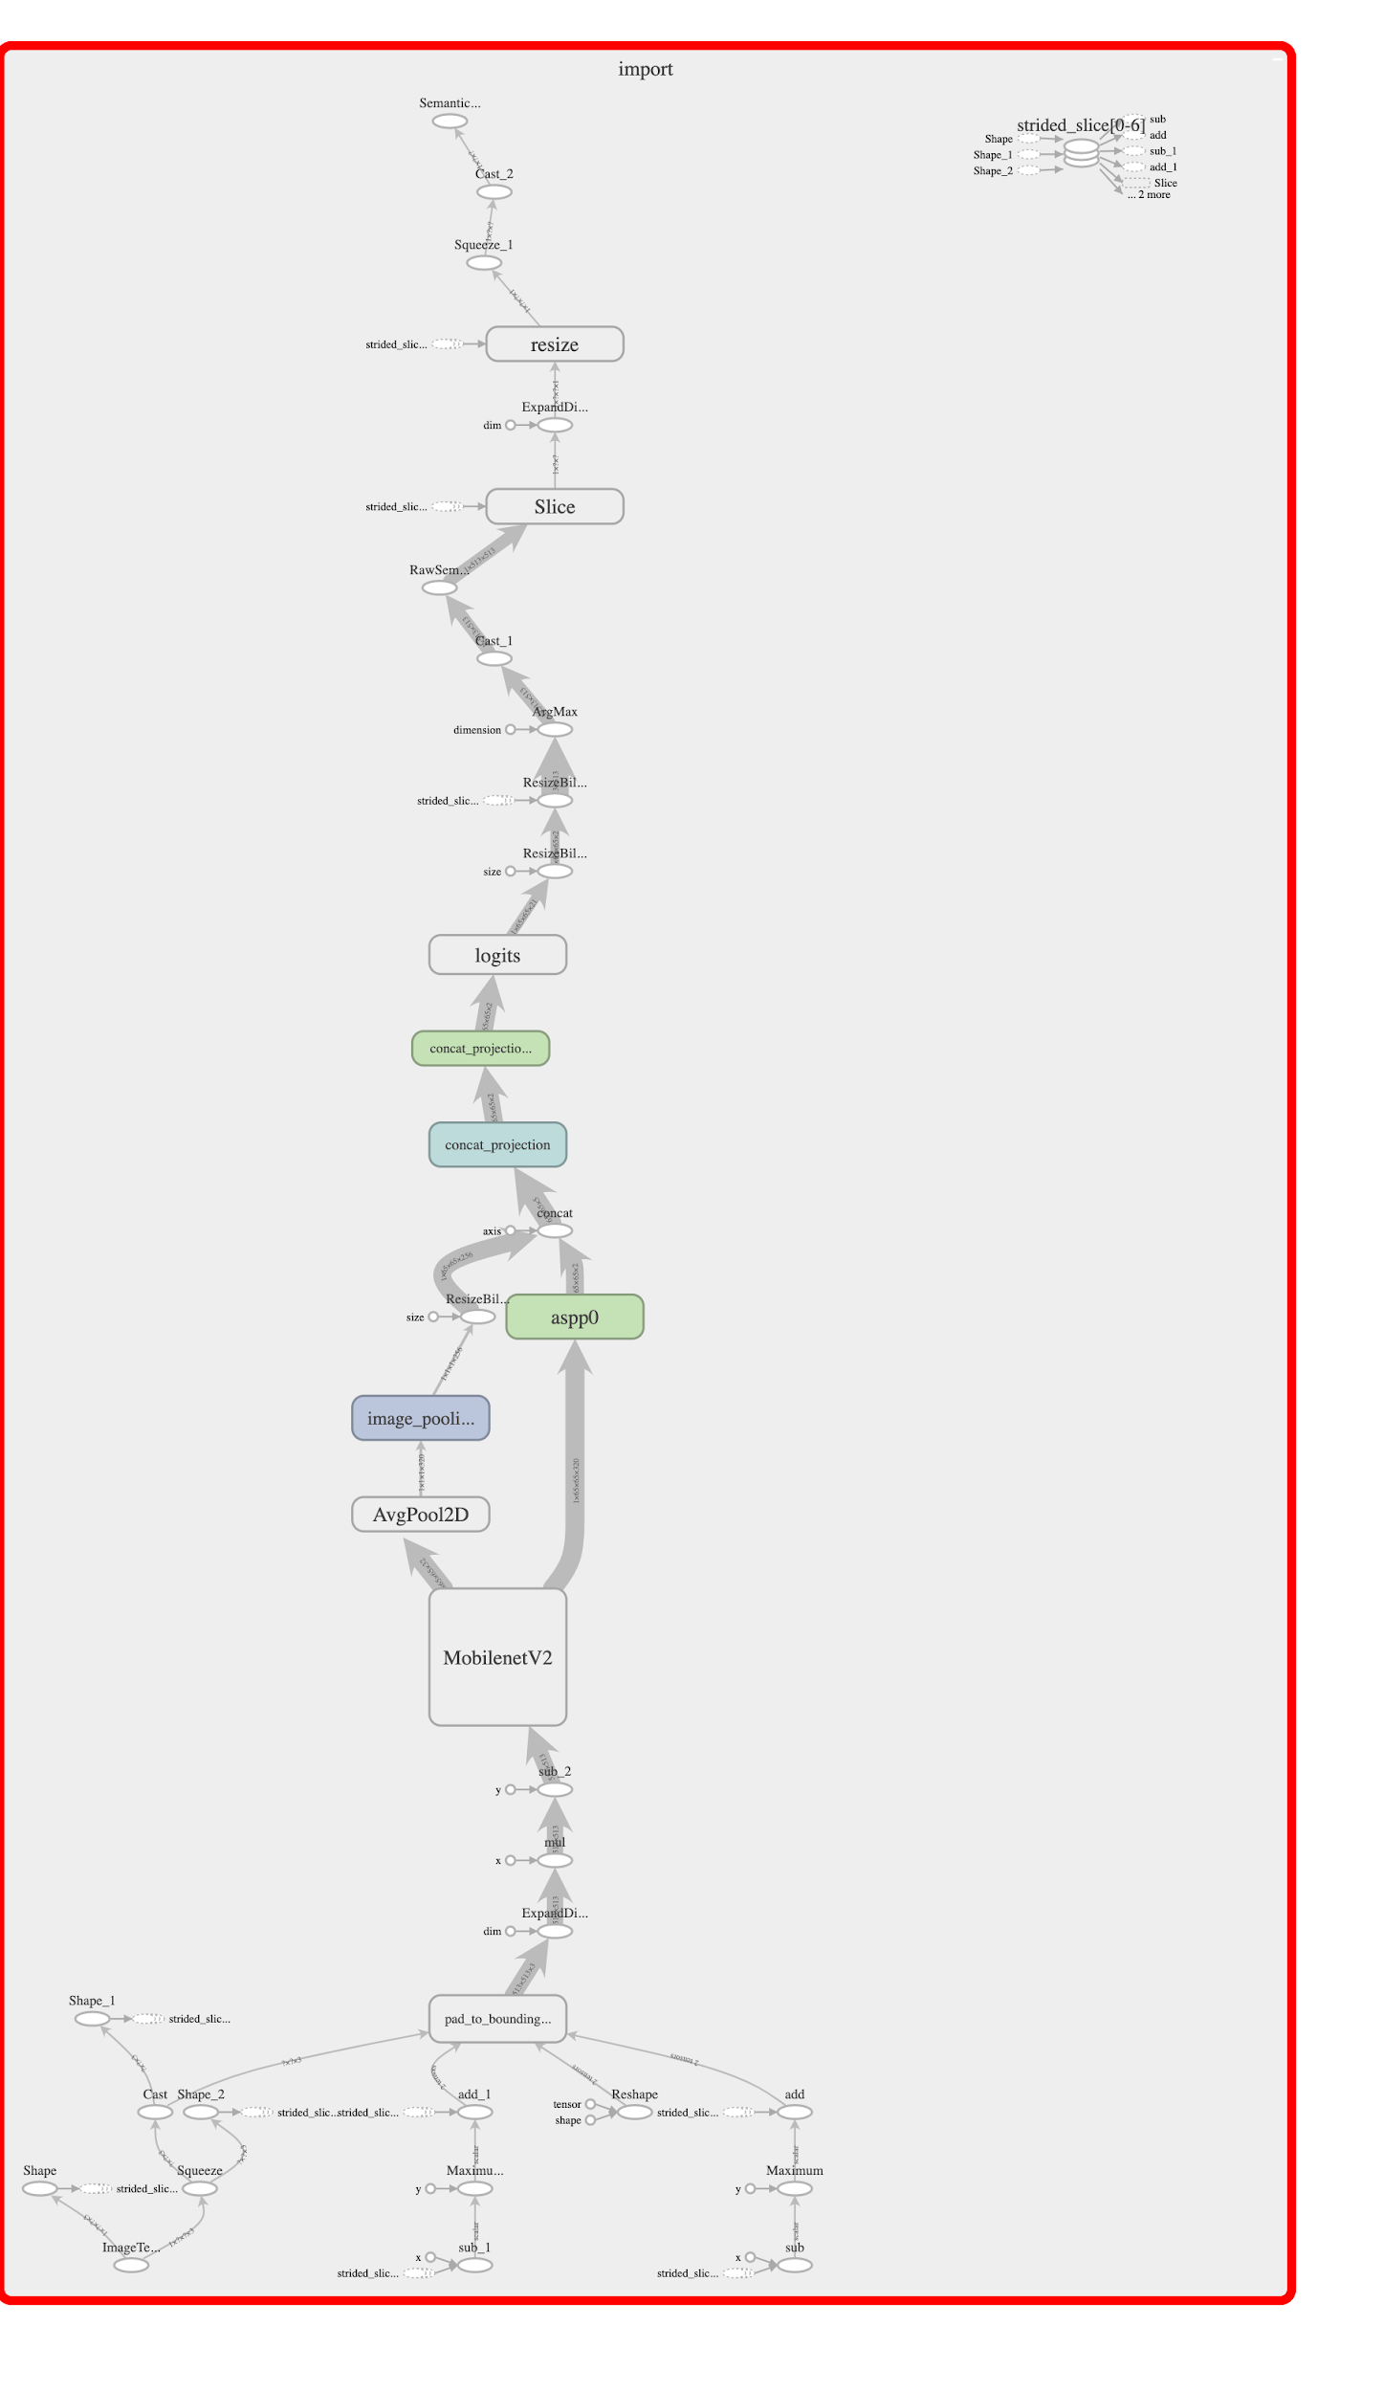
Quantization of DeepLab V3+
Pre Trained
DeepLab V3+ Model
Without Quantization

Slide 28
Quantization Aware Training : Pretrained Model
Pre Trained
DeepLab V3 Model
Without Quantization
Fine Tuning
Train with learning rate 3e-5

Slide 29
Quantization Aware Training : Pretrained Model
Pre Trained
DeepLab V3 Model
Without Quantization
Fine Tuning
Train with learning rate 3e-5
python deeplab/train.py
--base_learning_rate=3e-5
--training_number_of_steps=3000
--tf_initial_checkpoint=${PATH_TO_TRAINED_FLOAT_MODEL}

Slide 30
Quantization Aware Training : Pretrained Model
Pre Trained
DeepLab V3 Model
Without Quantization
Fine Tuning
Train with learning rate 3e-5
Export model
frozen_infernece_graph.pb

Slide 31
# From tensorflow/models/research/
python deeplab/export_model.py \
--checkpoint_path=${CHECKPOINT_PATH} \
--quantize_delay_step=0 \
--export_path=${OUTPUT_DIR}/frozen_inference_graph.pb

Slide 32
Quantization Aware Training : Pretrained Model
Pre Trained
DeepLab V3 Model
Without Quantization
Fine Tuning
Train with learning rate 3e-5
Export model
frozen_infernece_graph.pb
Convert to TFLite
frozen_infernece_graph.tflite

Slide 33
tflite_convert \
--graph_def_file=${OUTPUT_DIR}/frozen_inference_graph.pb \
--output_file=${OUTPUT_DIR}/frozen_inference_graph_quant.tflite \
--output_format=TFLITE \
--inference_type=QUANTIZED_UINT8 \
--inference_input_type=QUANTIZED_UINT8 \

Slide 34
Quantization Aware Training : Pretrained Model
Pre Trained
DeepLab V3 Model
Without Quantization
Fine Tuning
Train with learning rate 3e-5
Export model
frozen_infernece_graph.pb
Convert to TFLite
frozen_inference_graph.tflite
Run Inference on TFLite

Slide 35
Quantization Aware Training : Pretrained Model
Model Size:
Non Quantized | Quantized
8.6 Mb | 2.1 Mb

Slide 36
How is the Quantization Aware Training Performed?
Parameter to the training script “--quantize_delay_step”
To create tf.contrib.create_training_graph()
Used to train models for quantization..

Slide 37
Delayed Quantization
One of the .Next items that we showcased for the final milestone
Used when training and quantization have to be performed in the same cycle.
Quantization will be delayed until the last few steps.
Controlled by the argument ‘quant_delay’ for the function tf.contrib.create_training_graph()

Slide 38
Delayed Quantization
Trained a DeeplapV3+ model from scratch with the following parameters
python train.py
--training_number_of_steps=36000
--quantize_delay_step=30000
--base_learning_rate=0.0001
--initialize_last_layer

Slide 39
Quantization of DeepLab V3+.Next
Train deeplab float model with delayed quantization.
Current quantization was based on the MobileNetV2 (smaller model but less accuracy on new image inference); thus, subsequent Quantization effect is not clearly observable.
Quantization with different base architecture models (Xception, ResNet) to observe clearer quantization effect.

